Slide 1

Microbial Communities & Plastics: The Marine Environment
1
Andrew J. Otis
EBIO 4800
Notes:
Aesthetic Slide, don’t need to take up more than 20 seconds

Slide 2

About Me
2
I’m...
A BCHM/CHEM & EBIO major
2. A big fan of almost all animals
3. Attempting to provide an overview of general industry knowledge regarding plastics and their respective microbial communities in the Marine Environment
Notes:
Bigger interests in the biological aspect (rather than the biochemistry of it all)
Most people think it’s cool (which on the surface level, it is), but there are a lot of caveats many international student recruiters either forget to mention or omit all together and we’ll leave it at that.
If I’m not a fun of an animal, I’ll try to find cool facts about it to make it more appealing

Slide 3
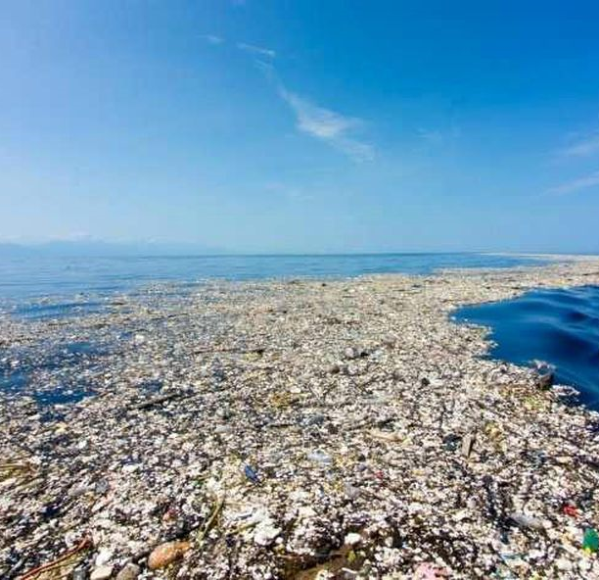
General Background
3
Global plastic production in the year 2017 was recorded to be about 350 million tones.
Countries & companies alike around the globe (not all) increased public pressure on the public and themselves to decrease the rate at which plastic waste accumulates in marine environments
Forbes. (2019, May 30). [Garbage stretching for miles]. The Ocean Cleanup.
Notes:
Point 1:
Plastic production since 2017 has only increased since then
Point 2:
Countries/areas not participating may be due to limited resources/manpower for such an operation OR a big stream of economic revenue is due to plastics and they are having a difficult time transitioning.

Slide 4
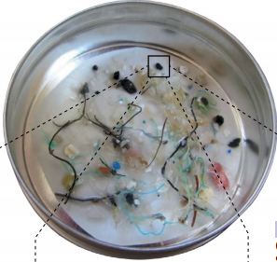
The “Plastisphere”
4
Electron Micrograph of biofilms on plastic substrates revealed the following categories of microbes
1. Saprotrophs
2. Symbionts
3. Predators
4. Heterotrophs
5. Phototrophs
Portion of Figure 3 from Amaral-Zettler, L.A. et al (2020) paper
Notes:
Figure interpretation
The microbes identified are in that tiny black square of the Petri dish. The bright colored pieces are likely to be the plastic substrate
1.
-Fungal hyphae
-”pit-forming” microorganisms
2.
-Sulfide-oxidizing ectobionts
3.
-Choanoflagellates
-Hydroid colonies
-Bryozoan colonies
-Suctorian ciliate
4.
-Spirochete bacteria
-Stalked bacteria
-Coccoid bacteria
-Bryozoan larvae

Slide 5
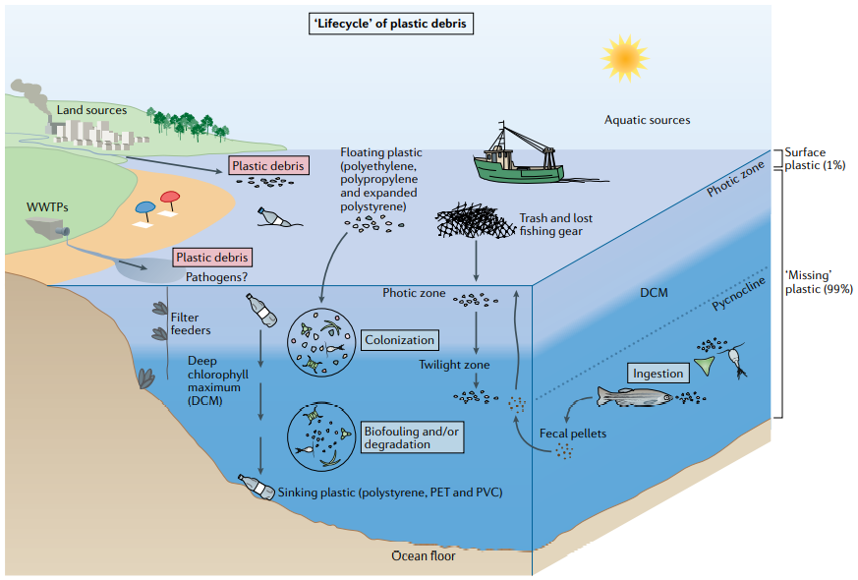
5
Figure 2 from Amaral-Zettler, L.A. et al (2020) paper
Plastics Lifecycle
Notes:
Figure Interpretation
Plastic debris enters global water ways through multiple pathways
Aquatic paths (rivers, fisherman nets and debris from boats, etc.)
Land sources (littering, runoff from waste water treatment plants a.k.a. WWTPs, etc.)
Once in global waterways, there are multiple ways plastics can become colonized
As floating plastic sinks to the bottom, they are colonized at the barrier at the end of the photic zone and at the beginning of the Deep chlorophyll maximum (DCM).
Filter feeders can ingest the smaller bits, as the plastic travels through the gut of the fish, microbes attach and colonize plastics
***NOTE***
Data for the figure only accounts for only about 1% of potential plastic (What has been recorded to be released into the ocean). The specific plastics accounted for are Polyethylene terephthalate (PET) & polyvinyl chloride

Slide 6
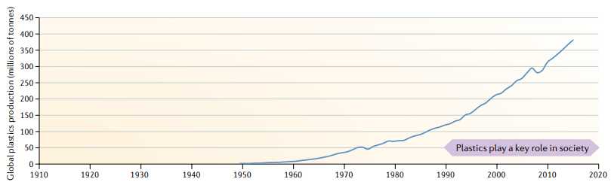
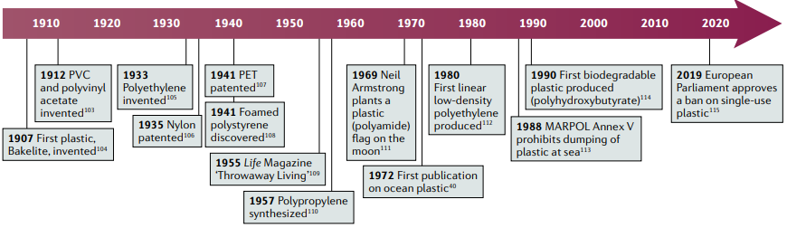
6
Figure 1 from Amaral-Zettler, L.A. et al (2020) paper
History of Plastics
Notes:
Figure 1 from Amaral-Zettler, L.A. et al (2020) paper
x-axis: Year
y-axis: Global Plastic Production (in weight)
We can observe the history of plastic inventions + the resulting regulations that arose from environmental problems as a result of environmental contamination/danger to workers/consumers
Simultaneously, we see a consistent rise in Global Plastic production since around the year 1950. We can conclude that plastics are an important tool (e.g. economic purposes, advances in plastic production to make something better with the same material).
However, due to current circumstances, it is clear as a collective, we are not so good at responsibly discarding the trash (at all levels, not just in the home).

Slide 7
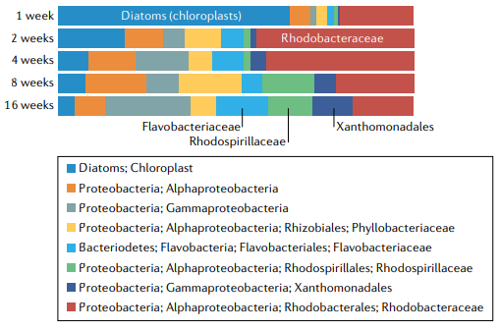
7
Microbial Community Composition
Colonization Experiment
Demonstrating changes in community composition, from a data base known as the Global Assignment of Sequence Taxonomy (GAST).
To identify and differentiate organisms, microscopy and a small subunit of rRNA marker gene is used (in this case, 16S rRNA gene)
Figure 4 from Amaral-Zettler, L.A. et al (2020) paper
Notes:
Point 1:
The general blueprint of a colonization experiment is to sample different substrates in the environment at various points in time and comparing their overall species richness and change over time. This includes something like Beta diversity (which we did with Adam during the Praxxis assignment)
Point 2:
I believe it has to be a neutral sequence that is present in all the identifiable organisms. And by neutral, it is non-recombinant (i.e. good marker for evolutionary history and speciation)
Figure Interpretation (from the perspective of the most abundant microbes at the start of the experiment)
Each bar is a sample collection at a specific period of time.
-Diatoms(chloroplasts) & Rhodobacteriaceae are the most abundant
-Over time, Diatoms (blue bar) remains on a consistent decreasing trend and by the end, was no longer a dominant species.
-In comparison, Rhodobacteriaceae experienced a big jump and had a less consistent decrease and by the end, was no longer dominant, but still able to compete

Slide 8
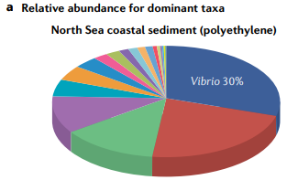
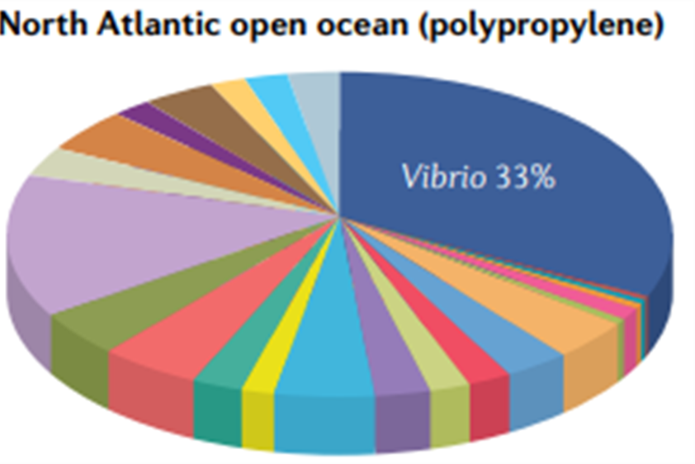
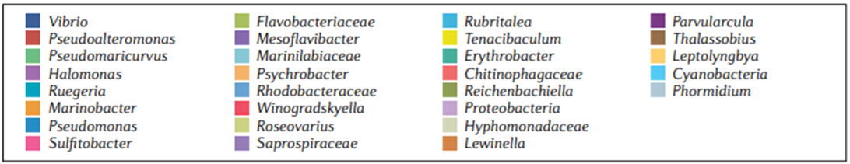
8
Relative Abundance
The figure demonstrates abundance of identifiable taxa with respect to one another.
In other words, the figures shown do not represent the actual amounts of each microbial species present, only their amounts relative to one another.
Figure 5-a from Amaral-Zettler, L.A. et al (2020) paper
Notes:
Figure interpretation
-For Coastal sediment & PET substrate sample, we can observe the taxa Vibrio & Pseudoalteromonas are the most dominant
-For Open Ocean & PET substrate sample, the taxa Virbrio and Proteobacteria are the most dominant.

Slide 9
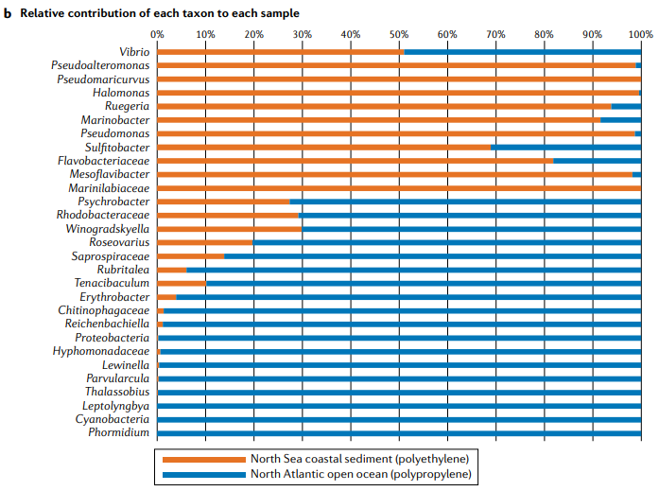
Contributions of each taxon for each sample location
9
Demonstrates the differences of relative abundance from each sample (from coastal sediment & one from the open ocean, BOTH using PET as the substrate)
Figure 5-b from Amaral-Zettler, L.A. et al (2020) paper
Notes:
Figure Interpretation
-Some taxon follow a similar trend to one another. Either only consisting in the sediment sample or only consisting in the open ocean sample.
-However, there are organisms who have been found to be present in each sample, implying that these microbes (who use plastic as a substrate) can survive in BOTH environments.
-With regards to bioremediation, this is extremely important, because it would be important to consider the dynamic environment that is the ocean.

Slide 10
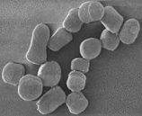
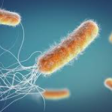
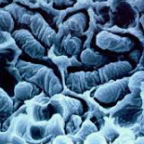
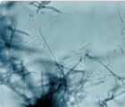
Microbes Relevant to Plastics Bio-deterioration & fragmentation
10
Classification & Scientific Name/Genus
*Gamma-proteobacteria
-Pseudomonas (Gram negative)
*Actinobacteria
-Arthrobacter (Gram positive)
*Corynebacteriaceae
-Corynebacterium (Gram positive)
*Nocardiaceae
-Rhodococcus (Gram positive)
*Microccaceae
-Micrococcus (Gram positive)
*Streptomycetaceae
-Streptomyces (Gram positive)
Pseudomonas
Arthrobacter
Streptomyces
Rhodococcus
Notes:
Main Idea
-These tests demonstrated that the stated microbes use plastic as their SOLE carbon source in LAB CONDITIONS.
-Bio-deterioration is referring biofilms (colonies of bacteria) growing on the surface and inside of the plastic. Leading to the break down of plastics and the formation of cracks
-Bio-fragmentation is referring to the process of extracellular enzymes (e.g. oxygenase, lipases, and other enzymes that specialize for multiple or a specific type of plastic polymer
*Gamma-proteobacteria
1. Pseudomonas (Gram negative)
*Actinobacteria
1. Arthrobacter (Gram positive)
*Corynebacteriaceae
1. Corynebacterium (Gram positive)
*Nocardiaceae
1. Rhodococcus (Gram positive)
*Microccaceae
1. Micrococcus (Gram positive)
*Streptomycetaceae
1. Streptomyces (Gram positive)
Gram Test Purpose/Goal
To identify positive or negative
Gram Positive Bacteria
Have a THICK peptidoglycan layer with NO outer lipid membrane
Gram Negative Bacteria
A THIN peptidoglycan layer and HAVE a outer lipid membrane

Slide 11
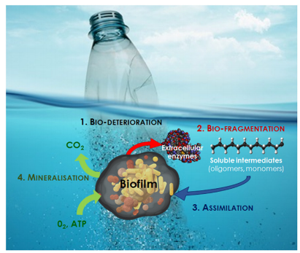
11
Indicators of Successful Biodegradation
Three measurements to determine success
More than 60 – 70% of ambient CO2 concentrations are due productions by microbes
Biological Oxygen Demand (BOD): Negative control should not exceed the upper limit of experimental parameters
Observable loss in mass and visual verification/evidence of degradation
Figure 2 from Jacquin et al. (2020) paper
Notes:
Point 1:
-Demonstrates that the plastic is indeed being used as a carbon (energy) source and that the rate of metabolic processes are feasible (occur at a sufficient rate) for the use of plastic bio-degradation IN THE LAB SETTING
Point 2:
-Negative Control
Refers to the control in an experiment that is also treated but is not expected to change (due to the treatment)
Point 3:
-Fairly self explanatory

Slide 12
In Conclusion
12
Microbe community composition are dependent on BOTH time and location (based on Amaral-Zettler, L.A. et al (2020) paper).
There are currently 4 biodegradation pathways for plastics (based on Figure 2 from Jacquin et al. (2020) paper).
One for each type of plastic PE, PET, and PS (polyethylene, polyethylene terephthalate, and polystyrene respectively).
One for a biodegradable plastic known as polyhydroxybutyrate (PHB)

Slide 13
Current Challenges: With respect to plastic as a substrate in the Marine Environment
13
Carrying capacity of microbial communities on plastic debris is unknown/not agreed upon
Majority of research have approached the topic from a colonization perspective
Working with microplastic samples yields extremely low biomass for DNA extraction
Knowledge of microbial communities in sediments are less common
Most studies on plastics have been done on bacterial and archaeal composition
Notes:
Point 1:
-Current methods of molecular approach that have been standardized still need some improvement, some molecular/genetic tags are believe to not be consistently reliable, due to the nature to DNA recombination.
Point 2:
-Which we had just discussed on the previous slides
Point 3:
-This adds to the expenses of the research, because it is already quite expensive to obtain samples and run experiments out in the middle of the ocean. Currently, the best techniques is Illumina MiSeq sequencing (i.e. HiSeq sequencing)
Point 4:
-More recent research has shown that eukaryotic microorganisms are consistently present on plastic substrates

Slide 14
Literature Cited
14
1. Amaral-Zettler, L.A. et al. Ecology of the plastisphere. Nat Rev Microbiol 18, 139–151 (2020). https://doi.org/10.1038/s41579-019-0308-0
2. Amaral-Zettler, L. A. et al. (2015). The biogeography of the Plastisphere: implications for policy. Frontiers in Ecology and the Environment, 13(10), 541–546. https://doi.org/10.1890/150017
3. Delacuvellerie, A. et al. (2019). The plastisphere in marine ecosystem hosts potential specific microbial degraders including Alcanivorax borkumensis as a key player for the low-density polyethylene degradation. Journal of Hazardous Materials, 380, 120899. https://doi.org/10.1016/j.jhazmat.2019.120899
4. Erik R. Zettler, et al. Environmental Science & Technology 2013 47 (13), 7137-7146 DOI: 10.1021/es401288x
5. Jacquin, J. et al. (2019). Microbial Ecotoxicology of Marine Plastic Debris: A Review on Colonization and Biodegradation by the “Plastisphere.” Frontiers in Microbiology, 10, 1–11. https://doi.org/10.3389/fmicb.2019.00865

Slide 15
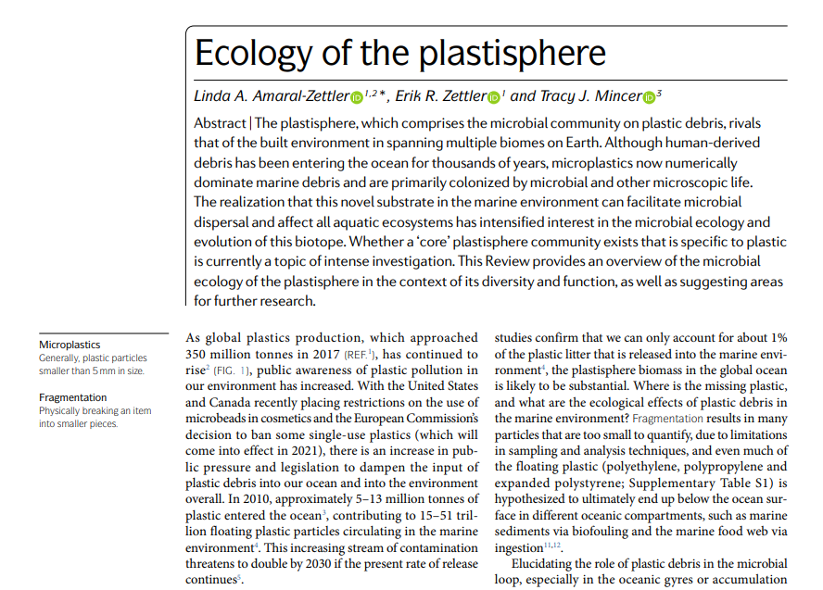
15

